Slide 1


“Redwings.com”-Online Blood
bank Portal
BY
Name | PRN No.
Pankaj Lokhande | 220941220081
Pravin Kadam | 220941220123
Under Guidance of
Mrs. Rupali Throat
Institute of advanced Computing and
Software Development Akurdi, Pune
September 2022

Slide 2
Index
01. Introduction
02. Problem Statement
03. Proposed System
04. Objective
05. Functional Specification
UML Diagram
6.1 ER Diagram
6.2 Use Case Diagrams
6.3 Class Diagram
6.4 DFD Diagrams
6.5 Activity Diagram
6.6 Sequence Diagram
07. Database Tables
08. Advantages
09. Disadvantages
10. User Interface
11. Conclusion

Slide 3
Introduction
In the time of emergency, it becomes difficult to approach the right donor. Rare blood groups are not available all the time at all blood banks and recipients find difficulties to track the right blood donor.
To overcome this problem, we proposed Redwings.com. There are many blood donation management systems, but these systems only maintain the information of blood banks and donors.
Our system is easy to maintain all the information about the blood donor and so much more.

Slide 4
Problem Statement
With the growing population and the advancement in medical science, the demand for blood has also increased.
We also have noticed that in corona pandemic there was so much blood requirement.
Due to the lack of communication between the blood donors and the blood recipients, most of the patients in need of blood do not get blood on time and hence they may lose their lives.
So many people die due to unavailability of blood every year.

Slide 5
Objective
To develop a system that provides functions to support donors to view and manage their information conveniently.
To maintain records of blood donors, blood donation information and blood stocks in a centralized database system.
To inform donors of their blood result after their donation.
To support searching, matching and requesting for blood convenient for administrators.
To manage the details of Blood, Donor, Blood Group, Blood Bank, Stock.
Fig. Flowchart of Proposed System

Slide 6
Operating Environment
Server Side:
Processor: Intel® Xeon® processor 3500 series
HDD: Minimum 500GB Disk Space
RAM: Minimum 4GB OS: Windows 10Linux 6
IDE: Open jdk 11.0.12 2021-07-20
Database: MySQL-8.0.30
Client Side (minimum requirement):
Processor: Intel Dual Core
HDD: Minimum 80GB Disk Space
RAM: Minimum 2GB
OS: Windows 7, Linux

Slide 7
UML Diagrams

Slide 8
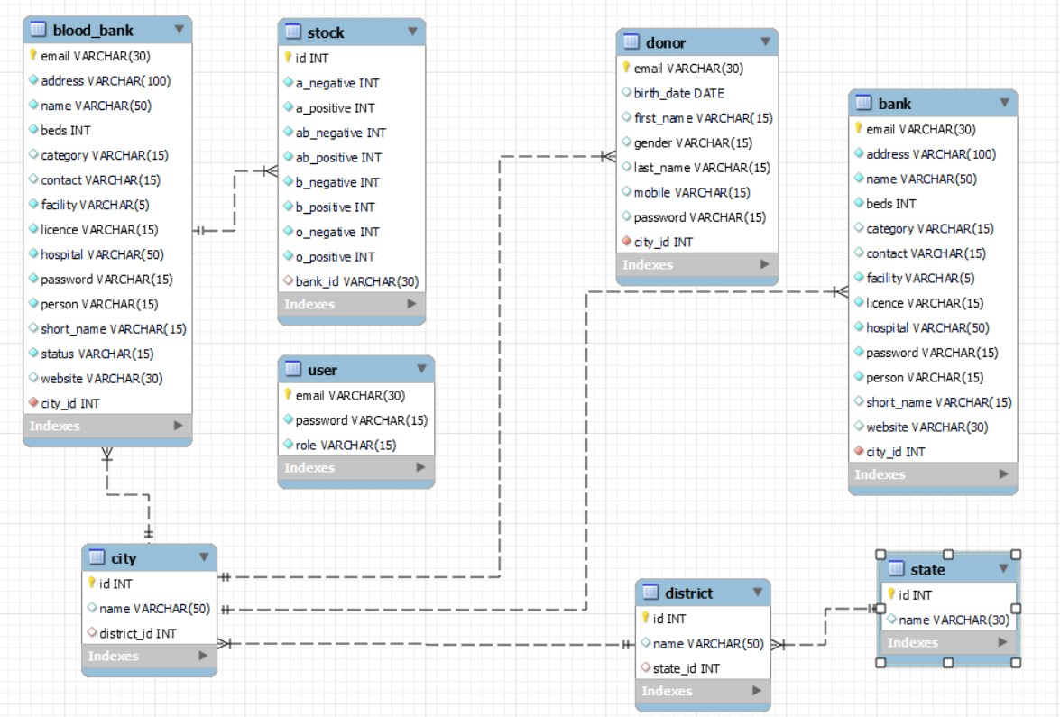
ER Diagram
Figure 1. E. R. Diagram

Slide 9
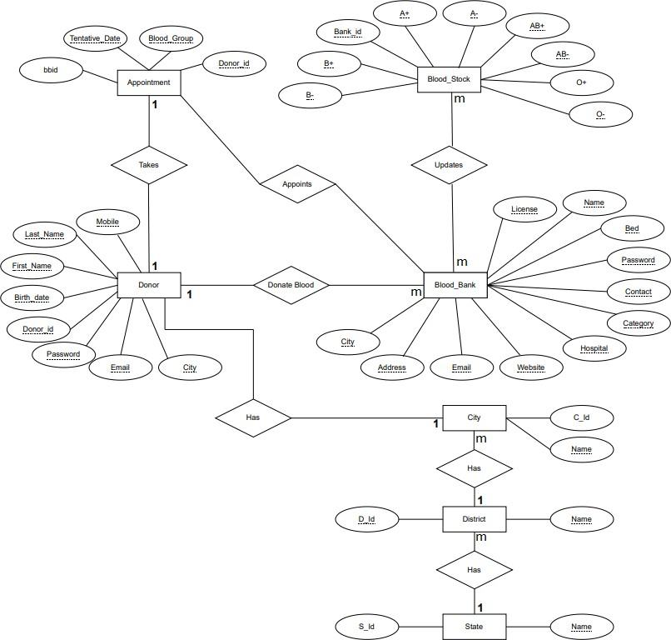

Slide 10
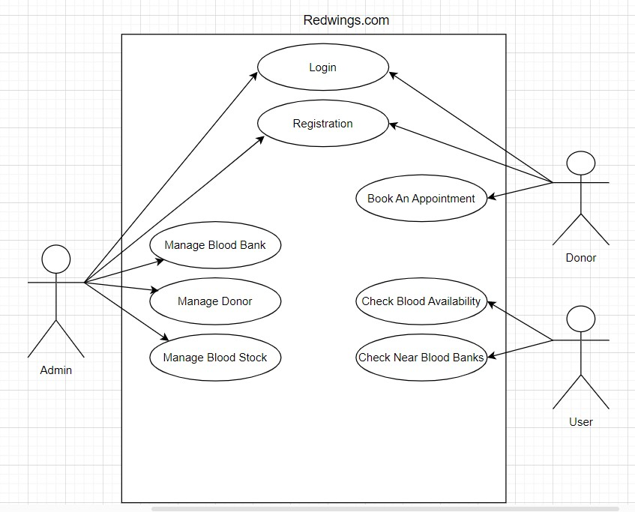
Use Case Diagram

Slide 11
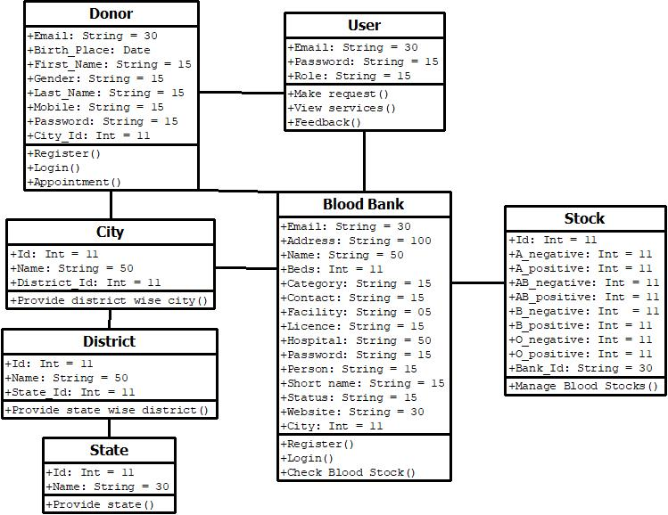
Class Diagram
*
1
1
*
1
1
*
1
*
1
Figure 4. System Class Diagram

Slide 12
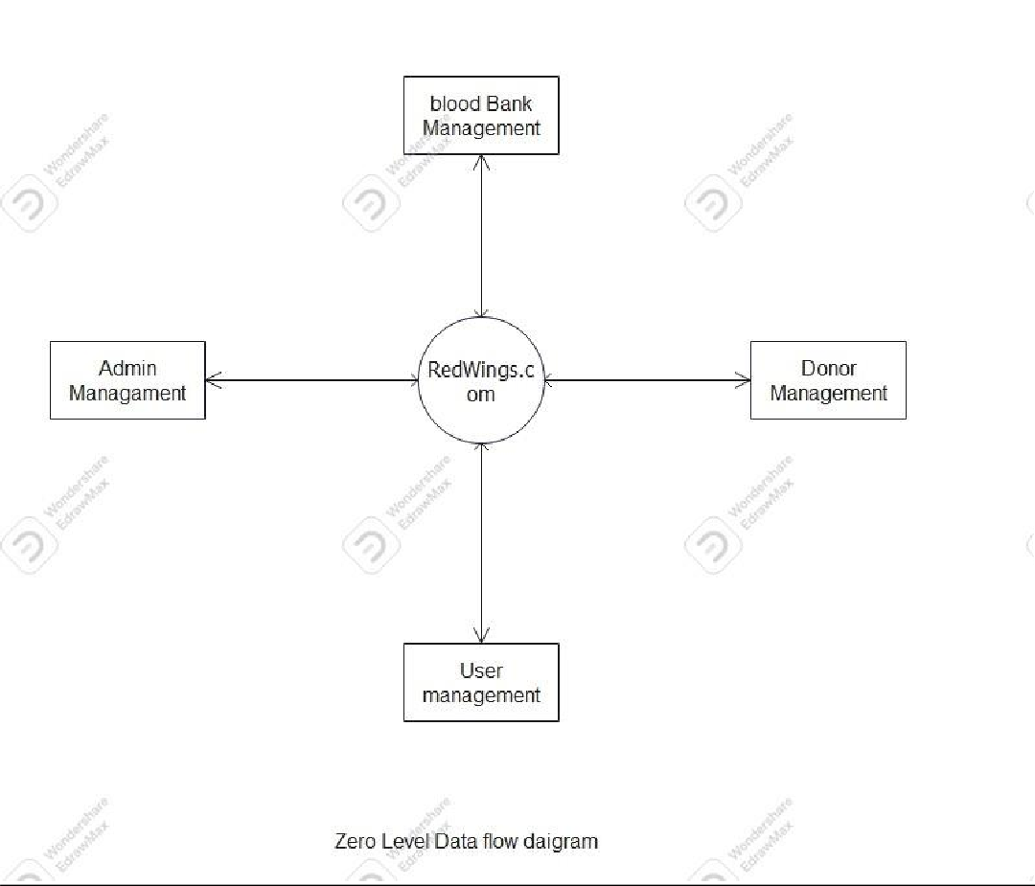
DFD Diagram
Zeroth Level DFD Diagram

Slide 13
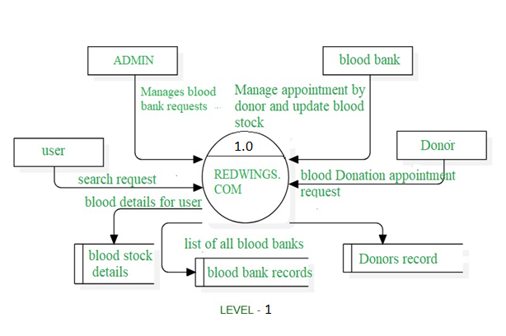
1st Level DFD Diagram

Slide 14
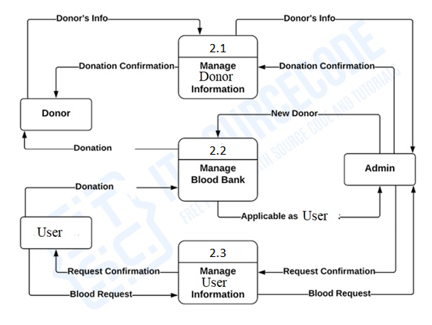
2nd Level DFD Diagram

Slide 15
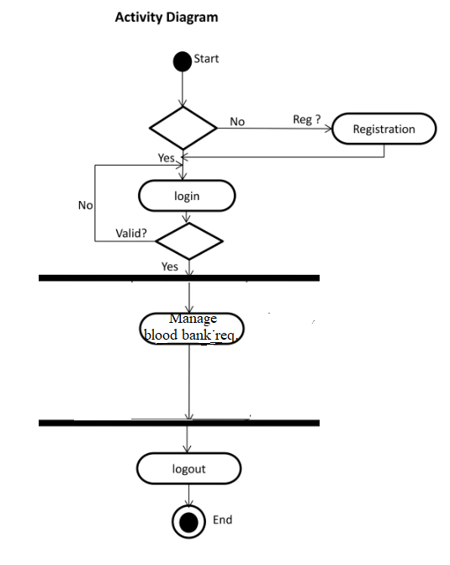
Activity Diagram
Activity Diagram for admin

Slide 16
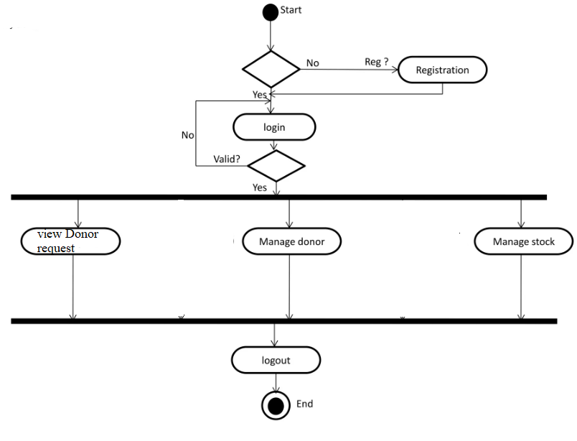
2.Activity Diagram for blood bank

Slide 17
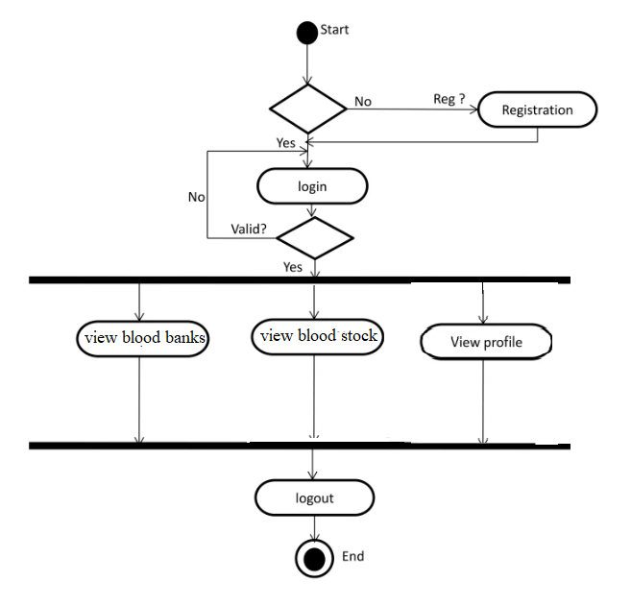
2.Activity Diagram for User

Slide 18
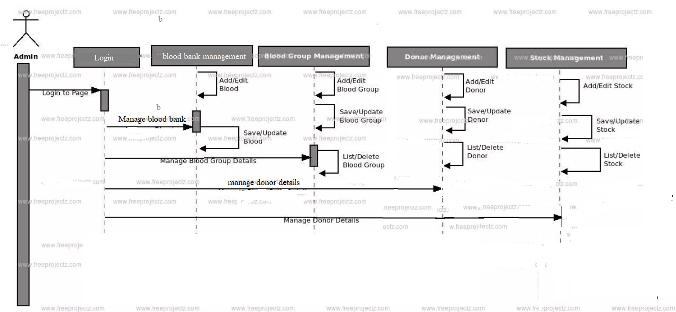
Sequence Diagram

Slide 19
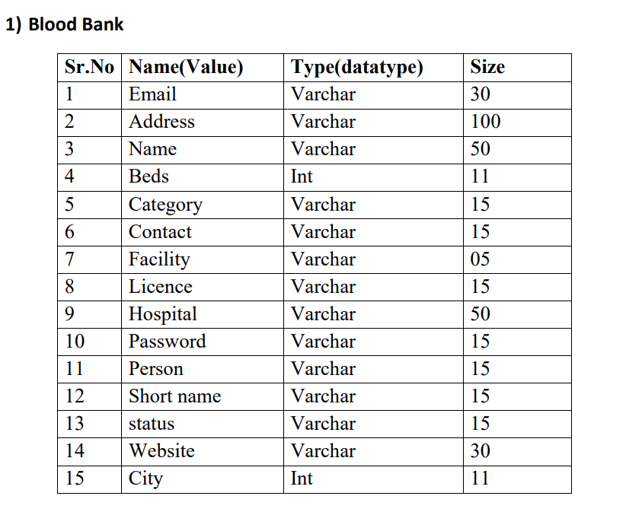
Database Tables

Slide 20
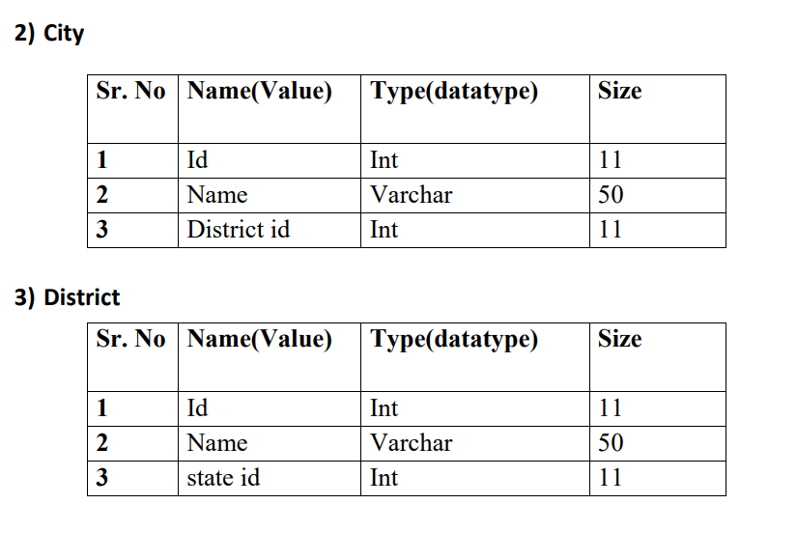

Slide 21
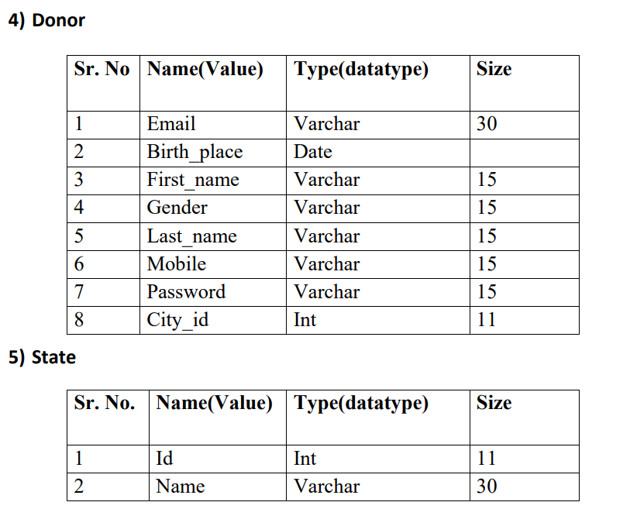

Slide 22
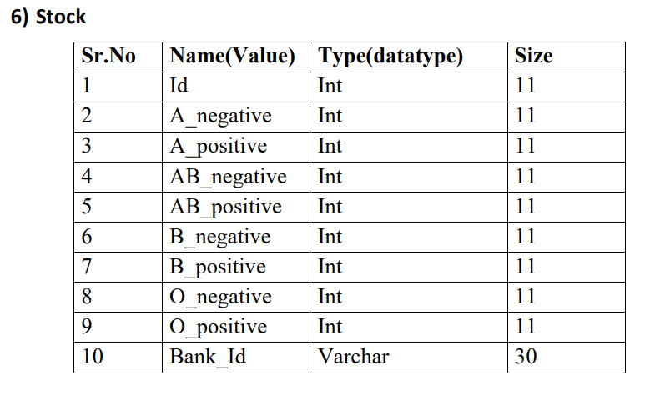
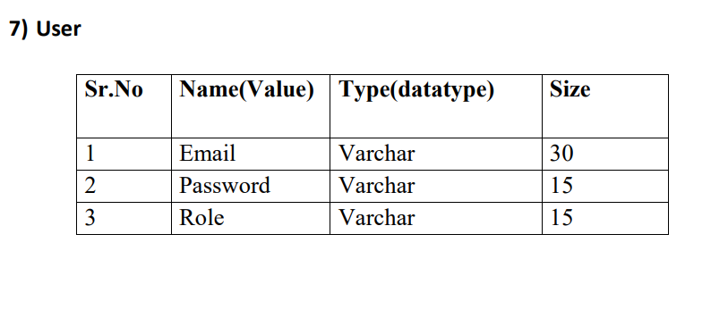

Slide 23
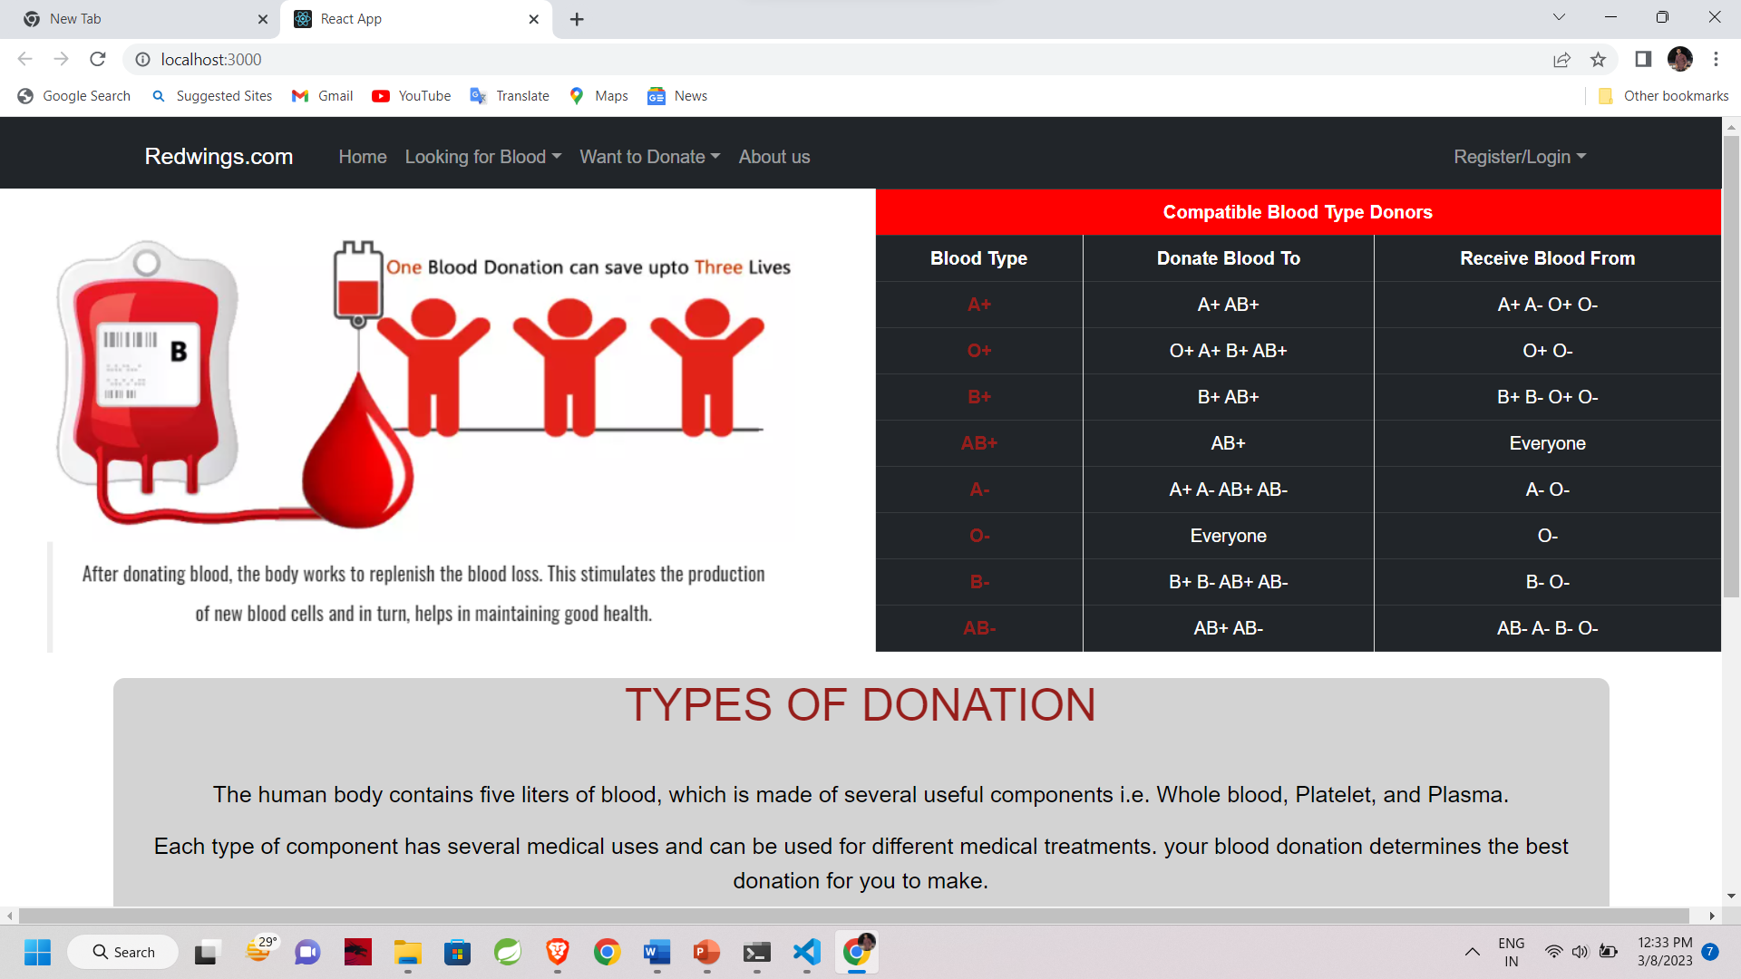
User Interface

Slide 24
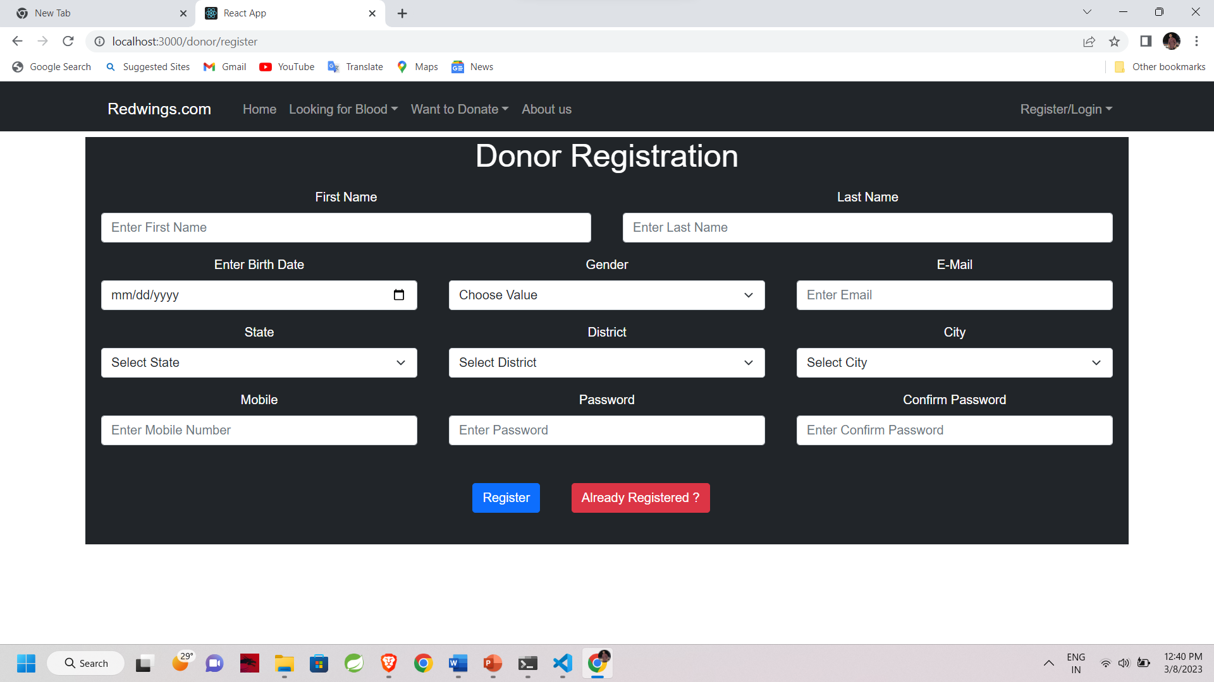
User Interface

Slide 25
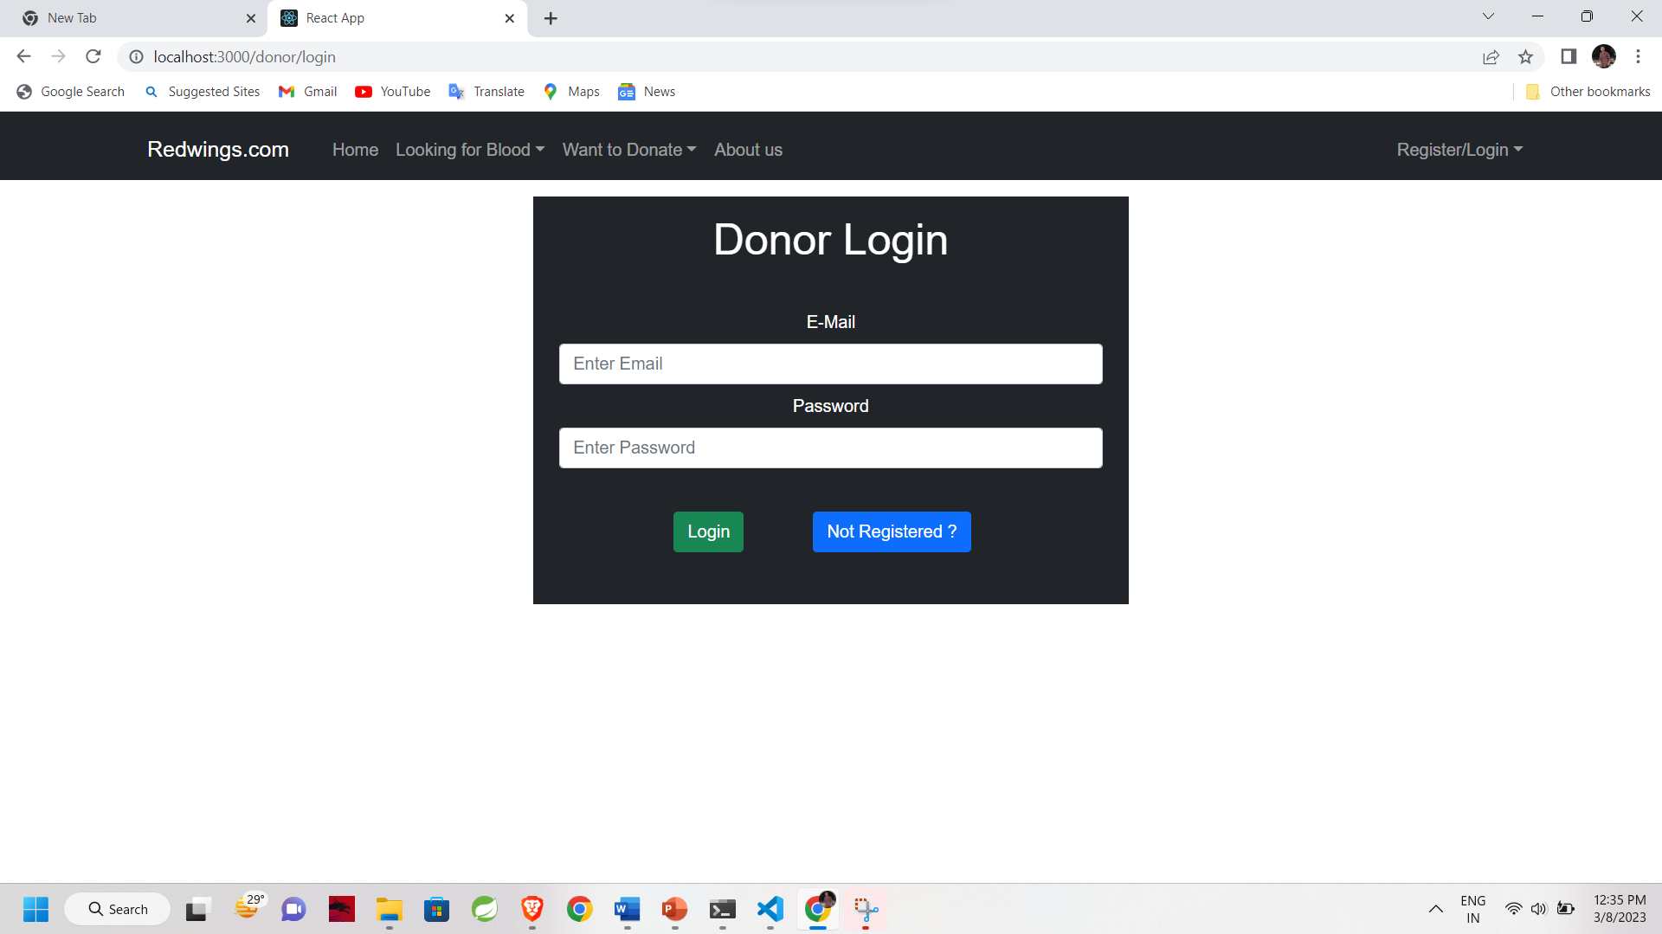
User Interface

Slide 26
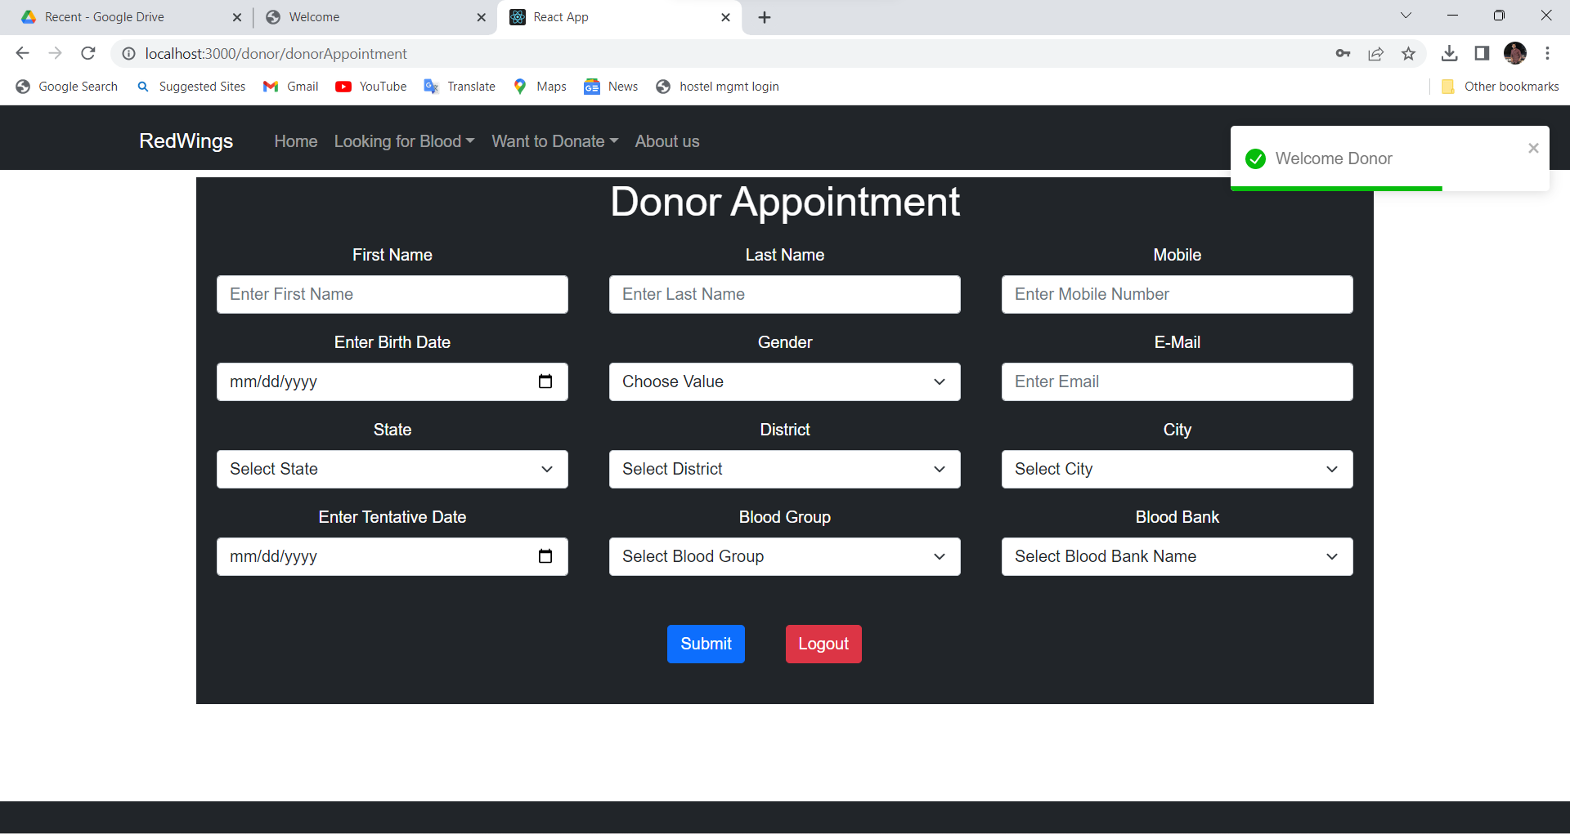
User Interface

Slide 27
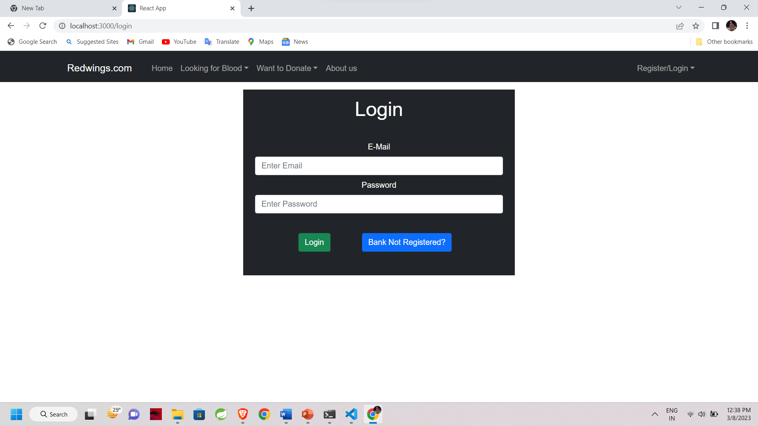
User Interface

Slide 28
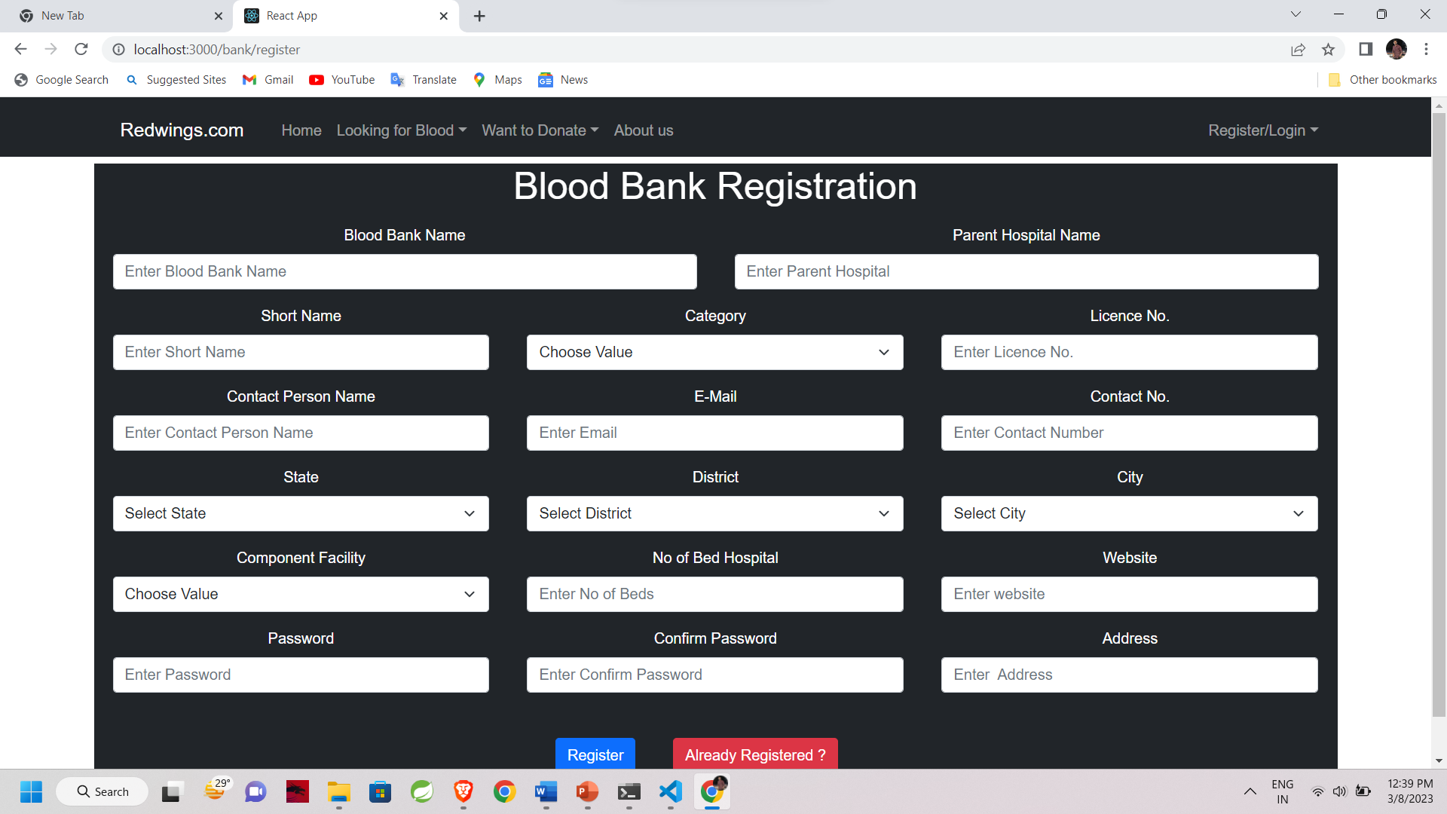
User Interface

Slide 29
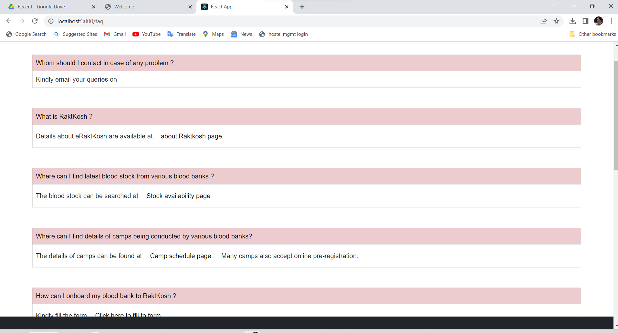
User Interface

Slide 30
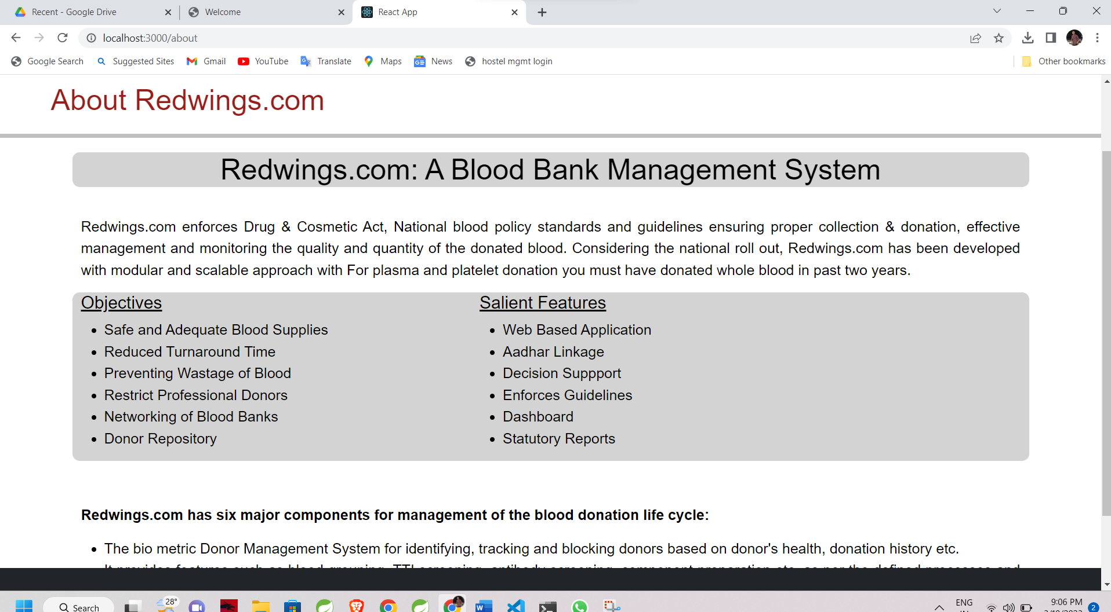
User Interface

Slide 31
Conclusion
The web site provides a way of communication and synchronization between the blood donors and the blood banks. It also help needy peoples to find blood in nearby blood banks in emergency.
Here, the individual can find the data of all blood groups and data of all blood banks.
It saves a lot of time and last but not the least, it can save many lives.

Slide 32
Thank You

